Slide 1
Chapter 9
How are Computers Connected?

Slide 2
Wires
Need at least two wires
Electricity must flow
Typically insulated
Often twisted
Ground
Alternate electrical path
In case of internal shorts

Slide 3
Twisted Pairs
Helps reduce interference
Differential mode signaling
Invented by Alexander Graham Bell
Telephone and Ethernet cables
Notes:
https://en.wikipedia.org/wiki/Twisted_pair

Slide 4
Jacks
Registered Jack “RJ”
RJ-11 for telephones
Two wire: tip and ring
~50 volts
Installation is expensive, wire is cheaper
Usually four or six wires run to each socket

Slide 5
Jacks
RJ-45
Ethernet
Eight wires
Four pairs

Slide 6
Cats
Categories for cables
Cat 1 – telephone
Cat 5 – unshielded twisted pair
Up to 1000BaseT
Cat 5e should have better crosstalk rejection
Cat 6 – up to 10GBaseT
10 Gigabits, baseband signaling, twisted pair
Book is off on the speeds, page 250

Slide 7
Crossover
Historically, one could connect two computers via a crossover cable and no hub/switch
Required the use of a crossover cable
These days, the network interface cards (NICs) recognize the signaling difference and do the right thing

Slide 8
Universal Serial Bus
1.0: 1.5 – 12 Mbps
2.0: 480 Mbps
3.0: 5 Gbps
Backwards compatible

Slide 9
Connections
Point to point wiring quickly become untenable
O(n²) connections
Star network
All components connected to central controller
Telephones in a company
Private Branch eXchange (PBX)
Wiring closets
Each new connection requires one wire

Slide 10
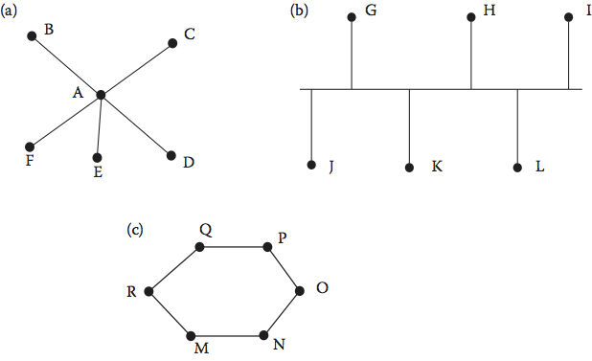
Architectures

Slide 11
Ethernet
A single shared bus
Broadcast
No need for centralized controller
Uses distributed control
No single point of failure
All communications seen by all machines
Header contains information about source and destination machines

Slide 12
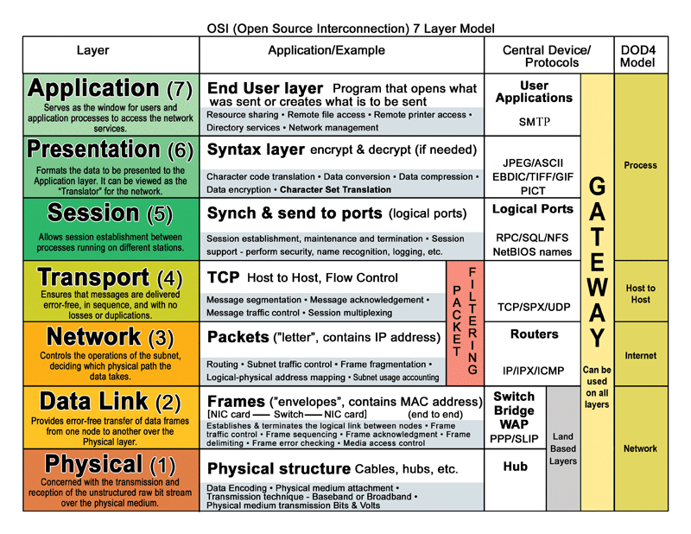
Network Stack: OSI Model

Slide 13
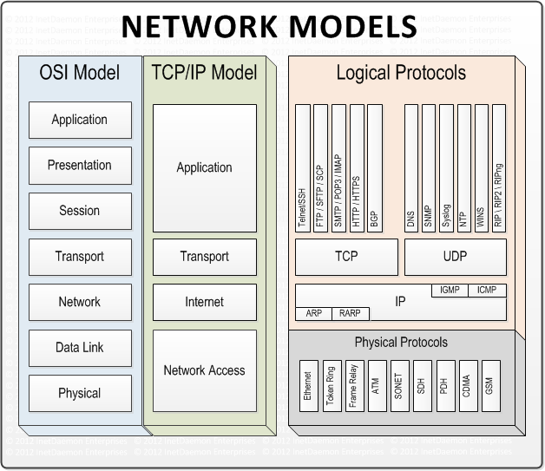
Network Stack: Protocols

Slide 14
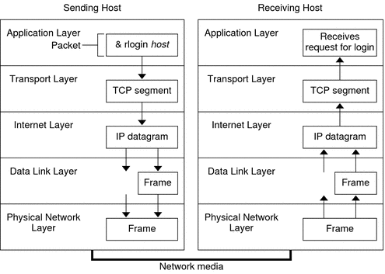
Network Stack: Peering Layers

Slide 15
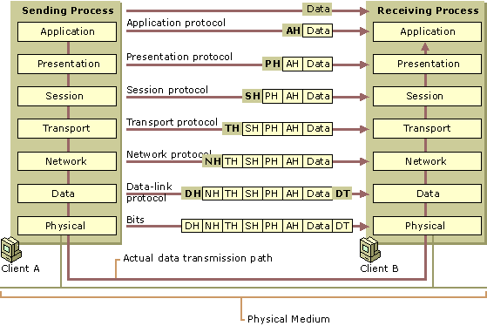
Network Stack: Headers & Chksum

Slide 16
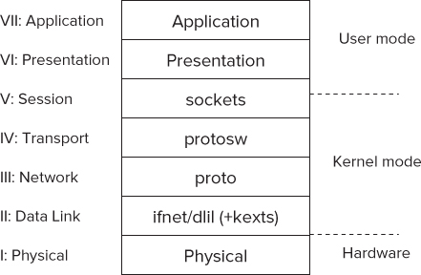
Network Stack: The OS View

Slide 17
Ethernet
Rules determine who can transmit
Listen before speaking
Still can collide as two can start at the same time
And there is delay
Listen while speaking
If collide, wait for a random amount of time and try again

Slide 18
Ethernet
Limited maximum amount of data transferred
~1500 bytes
~9000 bytes for jumbo frames

Slide 19
Hubs
Typically machines are connected to a hub or switch
Helps with the electrical characteristics
Hub works at the physical layer
Broadcast

Slide 20
Switches
Link layer
Typically, only the two machines involved see their traffic
Can reduce congestion
Switches learn the addresses of the connected machines
Routers work at the internet layer

Slide 21
Token Ring
Machines wired in a ring
Information circles the ring
To transmit, a machine has to capture the token
A specific bit pattern
Machine removes bit pattern and transmits data
No collisions, better under load

Slide 22
Token Ring
When data addressed to machine, it drains the data
And puts token back on
Sharing occurs around the ring
If originating machine see the data it sent, knows the destination machine did not get the data

Slide 23
Wireless
Similar to Ethernet
Broadcast, small packets, single talker
Somewhat more complicated
Multiple access points visible
Electrical interference
Laptops move from one LAN to another

Slide 24
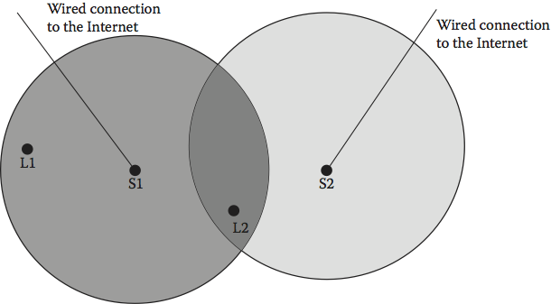
Example

Slide 25
Access Points
Identified by Service Set IDentifier (SSID)
Frequently randomly broadcast
To connect, machine sends association message
Might require credentials
Hopefully encrypted
Variety of speeds
54, 11, 5.5, 2, 1 Mbps

Slide 26
Hidden Machine Problem
Two machines might see AP, but not each other
Out of range of signals
Machine must request to send and receive confirmation

Slide 27
Ad Hoc
Machines can form networks to talk to each other even if not connected to internet
Zero configuration LAN
IP addresses typically start with 169.254
Each machine picks a random address and asks if any other machine already has that address

Slide 28
Review
Questions: 8
Exercises: 2, 3

